Slide 1
Visualizing and Understanding Convolutional Networks
By Patrapee Pongtana
Credit: Matthew D. Zeiler, Rob Fergus
Dept. of Computer Science, Courant Institute, New York University

Slide 2
Background of Convolutional Neural Networks
Previously, Alex Krizhevsky has achieved error rate as low as 16.4% on Top-5 Test
Architecture consists of 5 convolutional layers and 3 fully connected layers
Krizhevsky utilized
A large dataset that consists of millions of labeled examples
A powerful GPU to train a large model
A dropout method to regularize the better model
Notes:
Top 5 is simply a score that predicts the top 5 labels output. The 5 ones that has highest prediction

Slide 3
Motivation
To observe each layer’s highest activation on feature maps
To map these highest activation location back to input pixel space
To learn what machine learns
Notes:
Same filter + same switches

Slide 4
Multi Layered Deconvolutional Network
Performed under unsupervised learning
Max-pooling MUST be able to reversed back
The convolutional during reconstruct will perform conv transpose
Notes:
Unsupervised learning: Regardless of label; Input and reconstruct and keep top-level features sparse
No optimization (?)
Unsupervised because it does not learn anything new because convnet already learned the data already

Slide 5
Reconstruction
Switches

Slide 6
Feature Map
Top-9 Patches

Slide 7
Top-9 Highest of Activation from validation set

Slide 8
Top-9 Highest of Activation from validation set

Slide 9
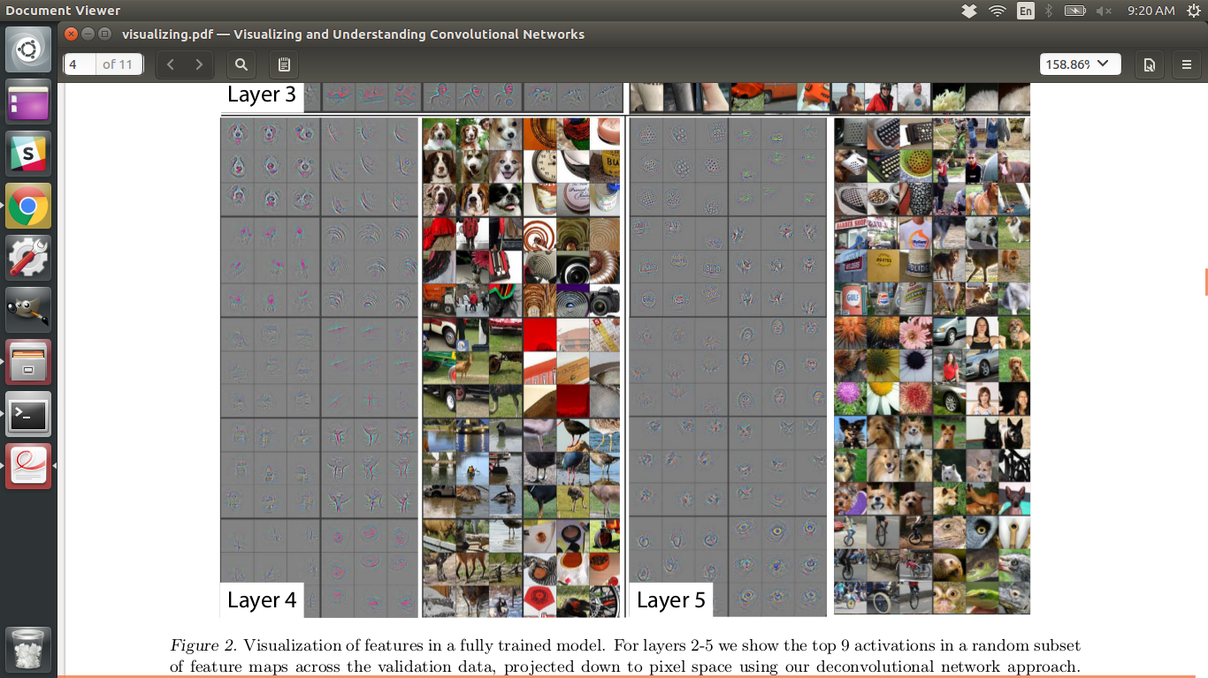
Top-9 Highest of Activation from validation set

Slide 10
Top-9 Highest of Activation from validation set
Layer 4

Slide 11
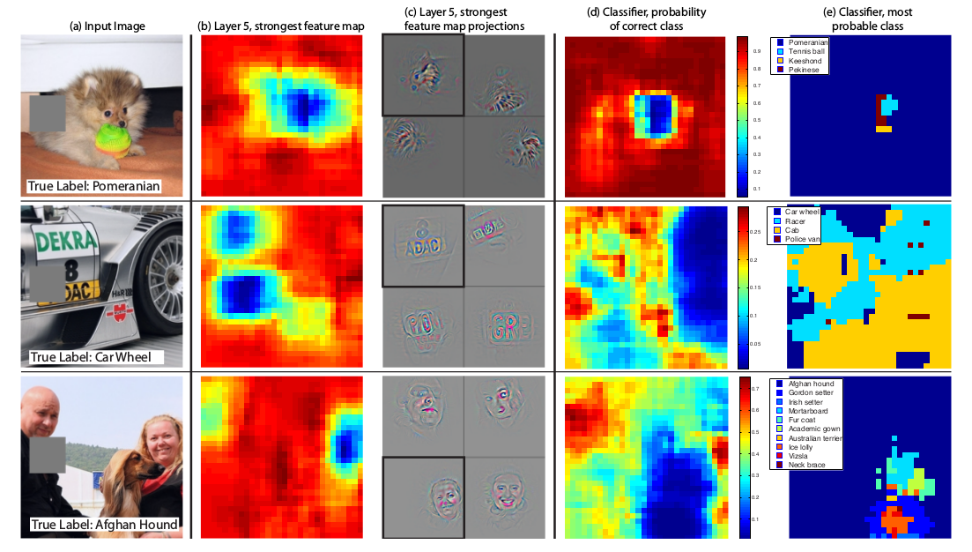

Slide 13
Matt Zeiber’s Architecture

Slide 14
Result

Slide 15
Conclusion
The visualization of how machine learn helps us improve the performance by exploring the key location of each pixel
E.g. We can know which hidden layer will be able to distinguish between human face and a dog face
The intuition of this research is to explain “how” and “what” hidden layers (conv layers) learn features with given filters

