Slide 1
Faster R-CNN
By Anthony Martinez

Slide 2
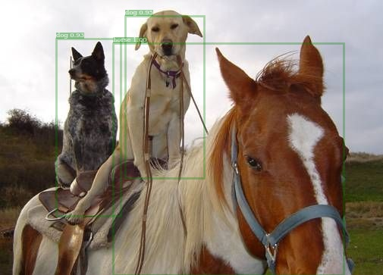
Faster R-CNN
(Object localization/ detection)
Dog
(Image classification)
VS

Slide 3
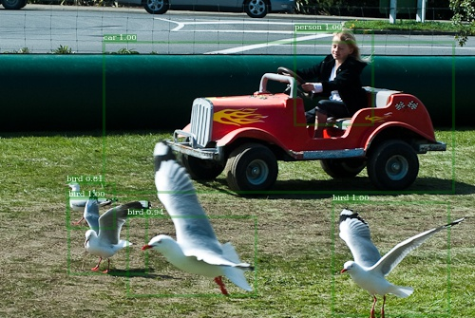
Faster R-CNN
Self driving cars?
Pedestrian detection
Surveillance
Data analysis
Extract information from images
…...
Why do we need this?

Slide 4
Faster R-CNN
Regions with Convolutional Neural Networks
(R-CNN)
{
Selective Search
Fast R-CNN
Faster R-CNN

Slide 5
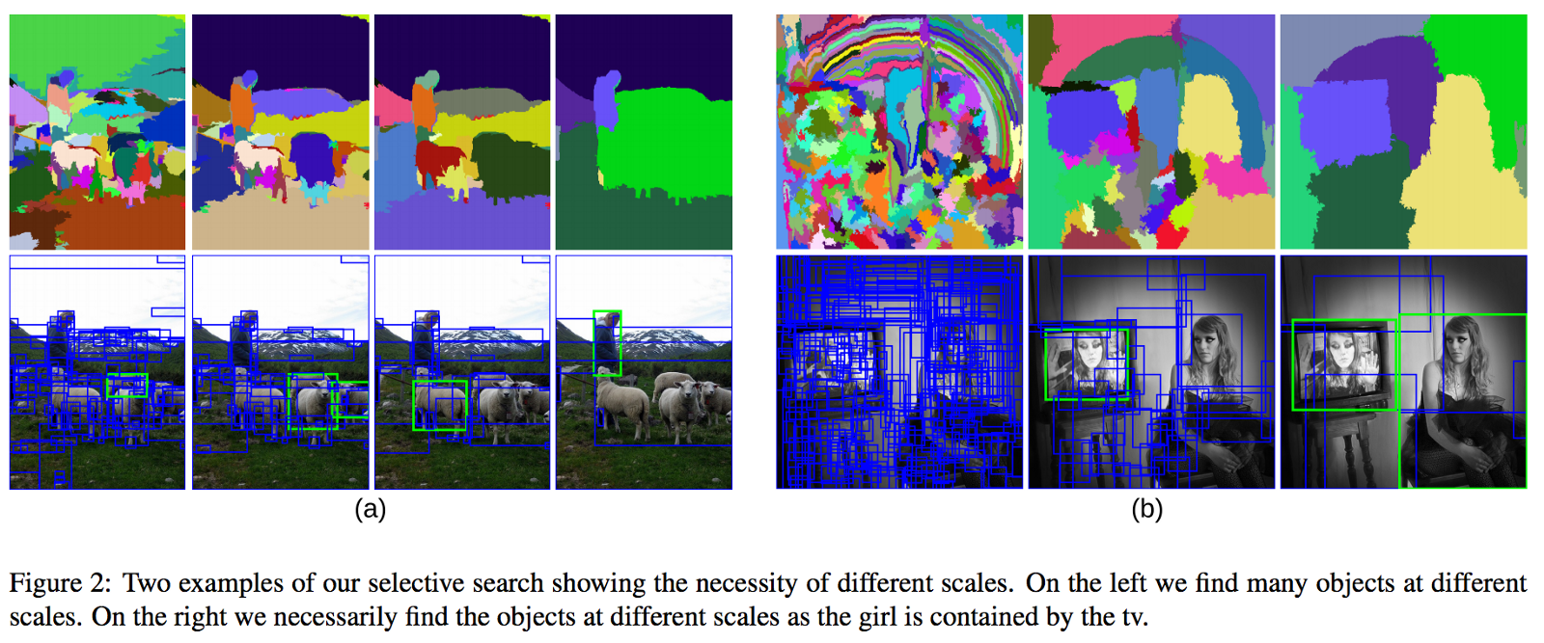
Selective Search
Bounding Box proposals

Slide 6
Selective Search
Faster R-CNN replaces bounding box proposals with a fully convolutional method.
Why? Because convolutions, that’s why!
Actually, SS was really slow.

Slide 7
Two main parts
Region Proposal Network
Fast R-CNN
(also this) Pre-trained network

Slide 8
VGG-16
image
Nothing to
See here.
13 sharable convolutions

Slide 9
VGG- 16
Feature Map
RPN
Fast R-CNN

Slide 10
Regional Proposal Network (RPN)
Foreground vs Background
Bounding Box regression
Feed bounding boxes into Fast RCNN

Slide 11
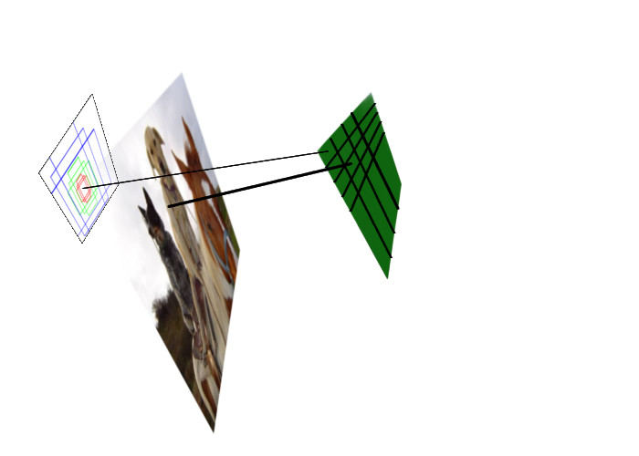
Mapping the center of the receptive fields
(0,0)
(1,3)
(0,0)
(16,48)

Slide 12
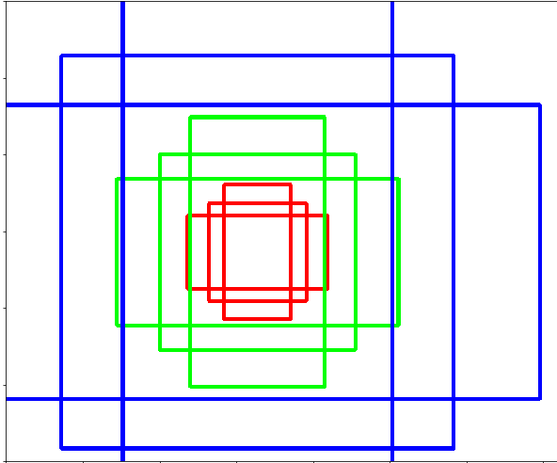
Anchor Boxes
k anchor boxes
3 scales (8,16, 32)
3 aspect ratios (.5, 1, 2)
Stride 16
WHk anchors
Feature Map
W
Nothing to
See here.
H
Center
(x,y)

Slide 13
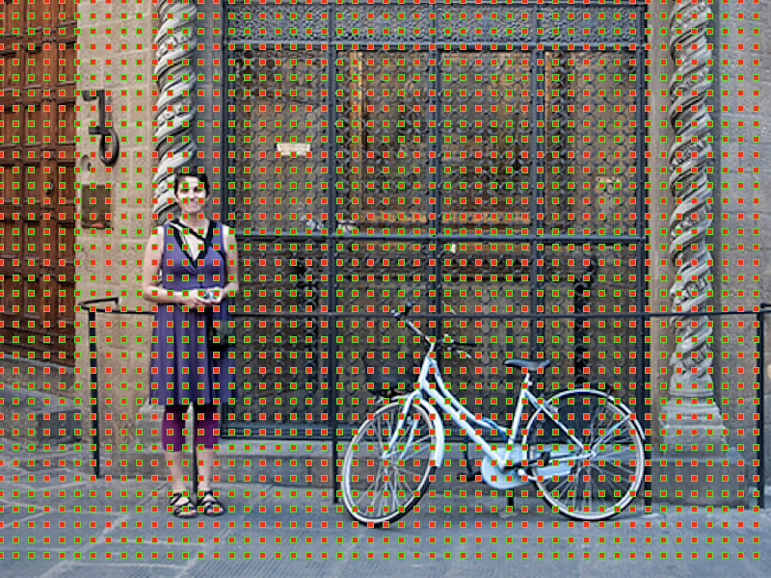
Anchor Boxes

Slide 14
Anchor Boxes

Slide 15
RPN
Object vs Not an Object
Anchor
Object = 1 to:
Anchors with the highest Intersection-over-Union(IoU)
IoU > 0.7 with any ground truth box.
Not object = -1
If IoU <0.3

Slide 16
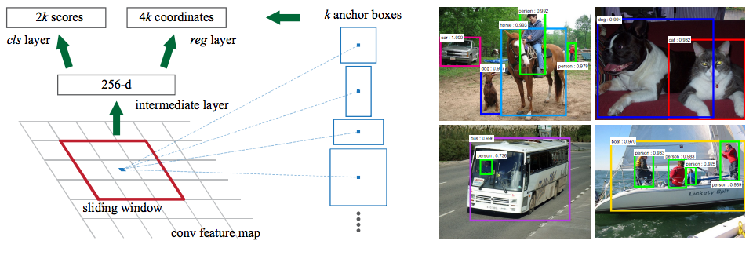
RPN
512-d
(x,y)
Mapping the center of the receptive fields
(Sx,Sy)

Slide 17
RPN
(512 × (2 + 4) × 9) parameters for VGG-16)
SigmoidCrossEntropyLoss SmoothL1Loss
512

Slide 18
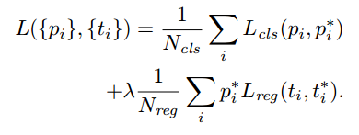
RPN
Mini batch size =256
Multi-task loss:
Hyper parameter =10
Only if p*= 1
Number of Anchor locations

Slide 20
Fast R-CNN
NMS
For each proposal
RoI Pooling
(Non-max suppression)

Slide 21
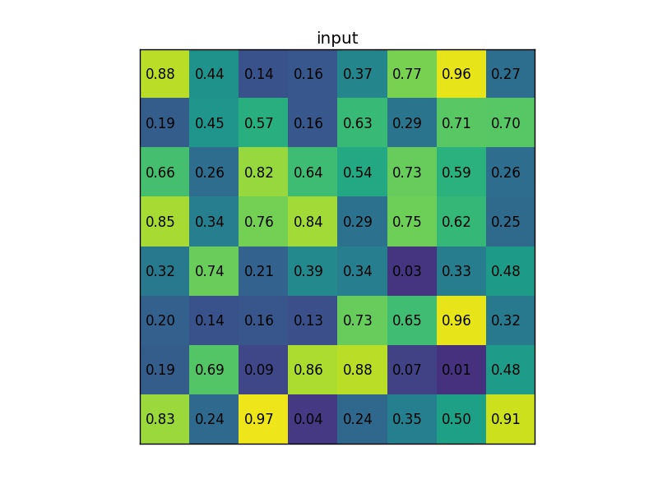
Fast R-CNN
Region of Interest (RoI):

Slide 22
Fast R-CNN
Region of Interest (RoI):
3X3 RoI pooling
.74 | .39 | .34
.2 | .16 | .73
.83 | .97 | .88

Slide 23
Fast R-CNN
7X7 RoI pooling
Per proposal
Region of Interest (RoI):
.74 | .39 | .34
.2 | .16 | .73
.83 | .97 | .88
Only a problem for segmentation

Slide 24
Fast R-CNN
softmax
label
RoI Pooling
Fully connected layers
NMS
For each proposal
Bbox regression
bbox

Slide 25
Pascal 2007
aeroplane | 0.6956
bicycle | 0.7861
bird | 0.7006
boat | 0.5905
bottle | 0.5609
bus | 0.7418
car | 0.7928
cat | 0.8337
chair | 0.4722
cow | 0.7728
Dining table | 0.619
dog | 0.8537
horse | 0.8002
motorbike | 0.7759
person | 0.7748
Potted plant | 0.4103
sheep | 0.6723
sofa | 0.672
train | 0.7412
Tv monitor | 0.656
mAP | 0.69612
1 GPU ~ 6 hrs.
ResNet50 with FPN
100000 iterations
Base LR: .0025
Steps: 30K, 40K -> *.1
RoIAlign

Slide 26
1 GPU ~ 5 hrs.
ResNet50
60K iterations
Base LR: .0025
Steps: 30K, 40K -> *.1
RoIAlign
1 GPU ~ 8 hrs.
ResNet50
100K iterations
Base LR: .001
Steps: 30K, 40K -> *.1
RoIPooling
mAP | 0.6425
mAP | 0.6667
1 GPU ~ 7 hrs.
ResNet50
100K iterations
Base LR: .002
Steps: 30K, 40K, 80K -> *.1
RoIAlign
1 GPU ~ 8 hrs.
ResNet50
200K iterations
Base LR: .001
Steps: 30K, 40K, 130K, 140K -> *.1
RoIPooling
mAP | 0.7023
mAP | 0.6031

Slide 29
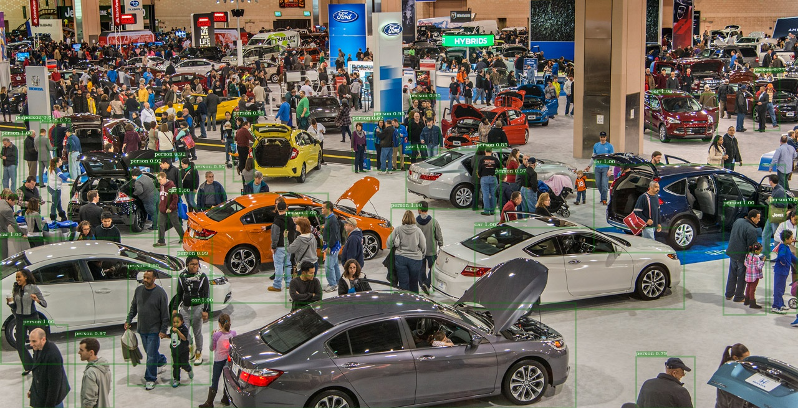

Slide 30
References
https://arxiv.org/pdf/1506.01497.pdf (Faster R-CNN)
https://arxiv.org/pdf/1504.08083.pdf (Fast R-CNN)
https://arxiv.org/pdf/1506.06981.pdf (R-CNN minus R)
https://koen.me/research/pub/uijlings-ijcv2013-draft.pdf (Selective Search for Object Detection)
https://arxiv.org/pdf/1703.06870.pdf (Mask R-CNN)
http://host.robots.ox.ac.uk/pascal/VOC/
https://www.dropbox.com/s/xtr4yd4i5e0vw8g/iccv15_tutorial_training_rbg.pdf?dl=0
http://kaiminghe.com/iccv15tutorial/iccv2015_tutorial_convolutional_feature_maps_kaiminghe.pdf
https://lovesnowbest.site/2018/02/27/Intro-to-Object-Detection/
https://blog.deepsense.ai/region-of-interest-pooling-explained/
https://tryolabs.com/blog/2018/01/18/faster-r-cnn-down-the-rabbit-hole-of-modern-object-detection/

