Slide 1
PixelRNN
Pixel Recurrent Neural Network
Presented by Andrew Fung

Slide 2
Agenda
What is PixelRNN?
Components of PixelRNN
Architectures of PixelRNN
Results of Experiments using PixelRNN

Slide 3
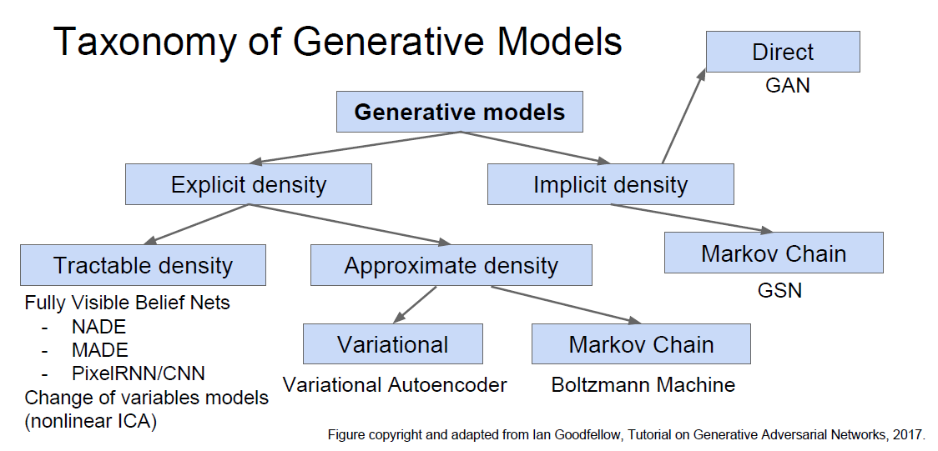
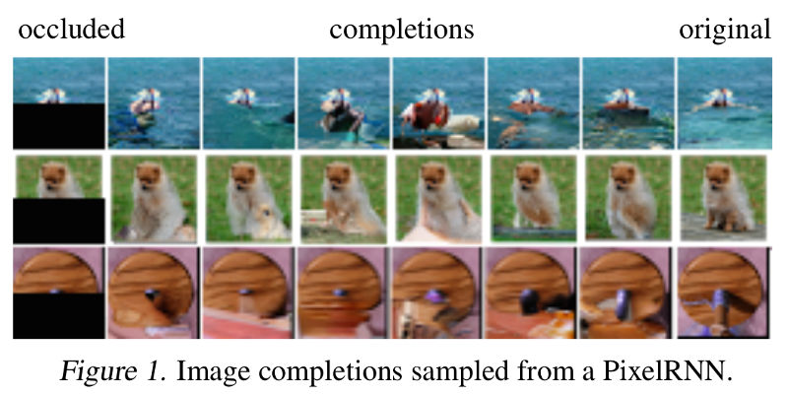
What is PixelRNN?
PixelRNN is a type of Generative Model
Generative Models are a subset of unsupervised learning
Generate new samples/data from same distribution
Used for Image Completion and Deblurring

Slide 4
What is PixelRNN?
Goal of this paper is to estimate a distribution over natural images that can be used to tractably compute the likelihood of images and to generate new ones
Read pixel by pixel
Each pixel depends on prior pixels that has already been read

Slide 5
What is PixelRNN?
Each pixel is also determined by three values (RGB)
Predicting Red, based on generated pixels
Predicting Green, based on value of Red
Predicting Blue, based on values of Red and Green

Slide 6
What is PixelRNN?
Since we know the conditional probability of our pixel value, we use a 256 softmax layer
Assign a probability p(x) to each image formed by n x n pixels

Slide 7
Key Components of PixelRNN

Slide 8
Masked Convolution
Masking is used to maintain the number of channels in the network
There are two types of masking:
Mask A:
Only applied to the first convolutional layer and restricts connections to those colors in current pixels that have already been predicted
Mask B:
Applied to other layers and allows connections to predicted colors in the current pixel

Slide 9
Residual Connections
PixelRNNs are trained up to 12 layers
Mainly used to increase convergence speed and propagate signals more directly through the network
Placed between one LSTM layer to the next

Slide 10
Proposed Architectures

Slide 11
Review RNN/LSTM

Slide 12
Row LSTM
Unidirectional layer, row by row, top to bottom
Computes features for a whole row at once
Kernel size: K x 1 where k >= 3
Triangular receptive field
Hidden state(i,j) = Hidden state(i-1,j-1)+ Hidden state(i-1,j+1)+ Hidden state(i-1,j)+ p(i,j)
Isn’t able to cover the entire available region

Slide 13
Diagonal BiLSTM
Starts at both top corners and goes towards the opposite bottom corners
Begin by skewing the image so it can easily apply convolutions along diagonals
Kernel of 2 x 1
pixel(i, j) = pixel(i, j-1) + pixel(i-1, j)
To combine the two output maps, the right side is shifted down one row then added to the left output map

Slide 14
PixelCNN
PixelRNN is very slow when training
Uses standard convolutional layers to capture a bounded receptive field and compute features for all pixels
No pooling layers
Masks are adopted to restrict the model from violating the conditional dependence
Performance worse than PixelRNN due to presence of a Blind Spot

Slide 15
Multi-Scale PixelRNN
Composed of an unconditional PixelRNN and one or more conditional PixelRNNs
Unconditional network generates a s x s image that is subsampled from the original image
Conditional network then takes the s x s image as an additional input and generates a larger n x n image

Slide 16
Visual of the three architectures

Slide 17
Experiment Results
CIFAR-10
MNIST
ImageNet

Slide 18
References
Oord, Aaron van den, Kalchbrenner, Nal, and Kavukcuoglu, Koray. In Pixel Recurrent Neural Networks, 2016.

Slide 19
Thank you

